Slide 1
How Walking or Biking to Work Can Save the World
Brett mcIff, PhD
Utah Department of Health

Slide 2
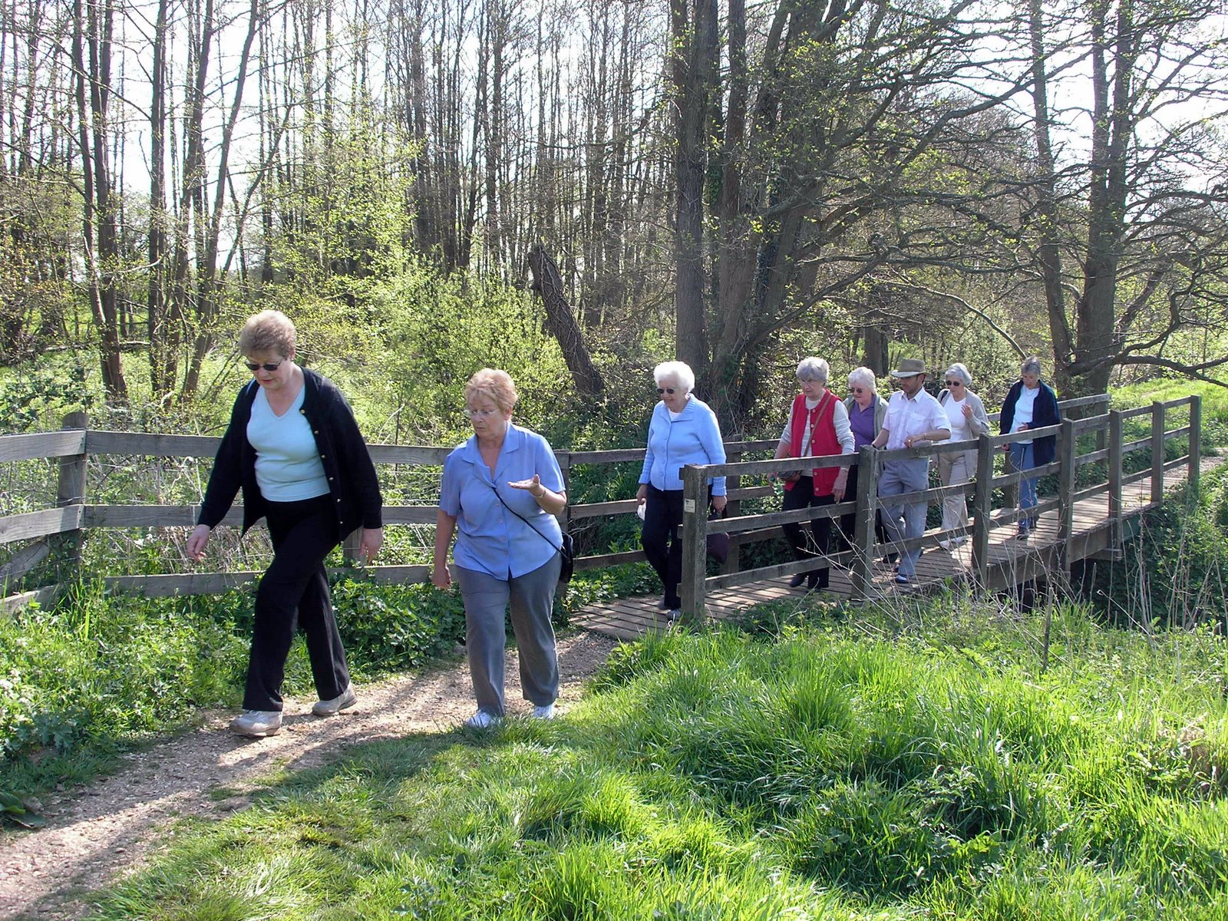
Why Is Health Even Involved?
Air Quality
Injury Prevention
Obesity and Overweight
Heart Disease, Stroke, Diabetes, Cancer, Asthma, Arthritis, and much more!

Slide 3
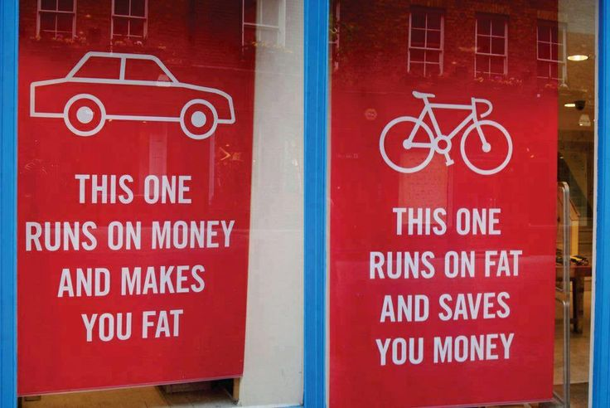
Because Transportation IS Health, and Health is Life

Slide 4
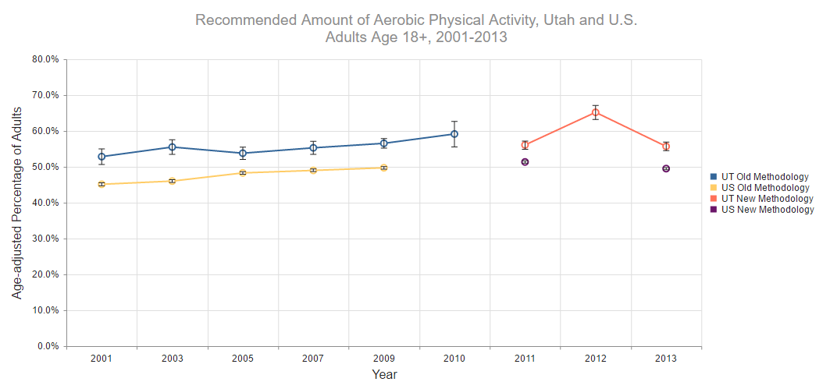

Slide 6
Health and Active Transportation
In the last 30 days, how many days have you walked to work, school, church, or other destination other than for recreation or exercise?

Slide 7
Health and Active Transportation
In the last 30 days, how many days did you bike for transportation?

Slide 8
Health Equity: Not Just Words...

Slide 9
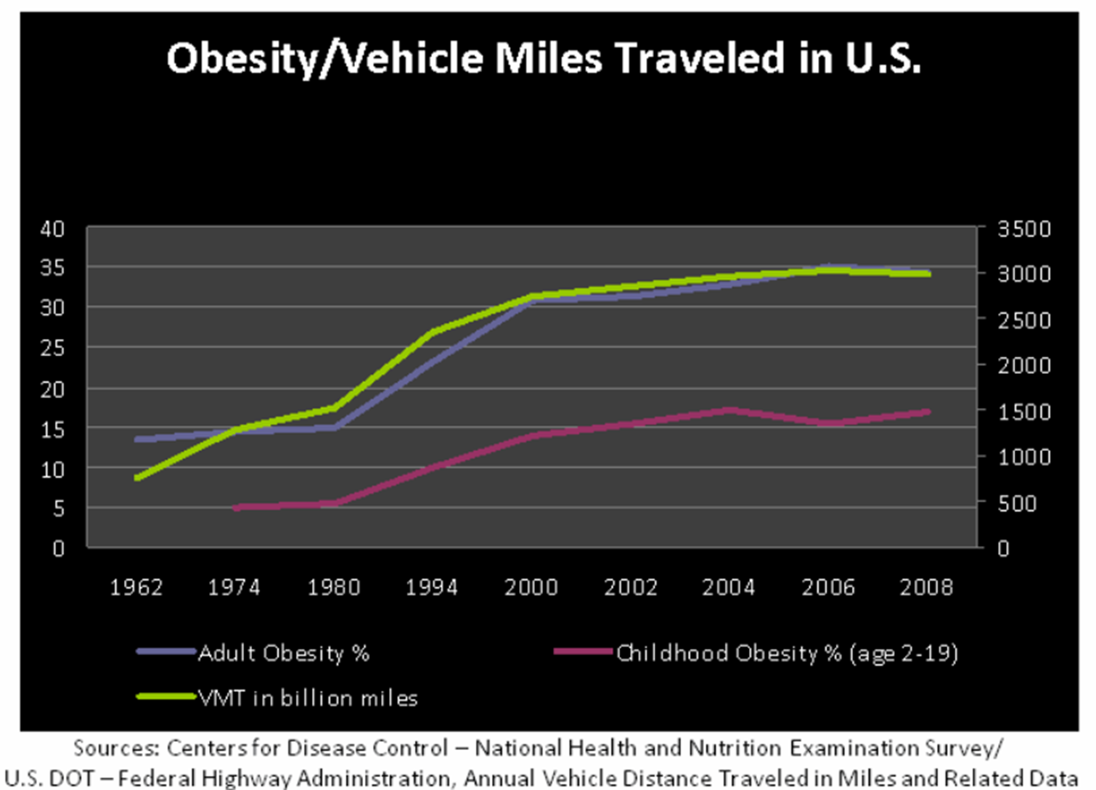

Slide 10
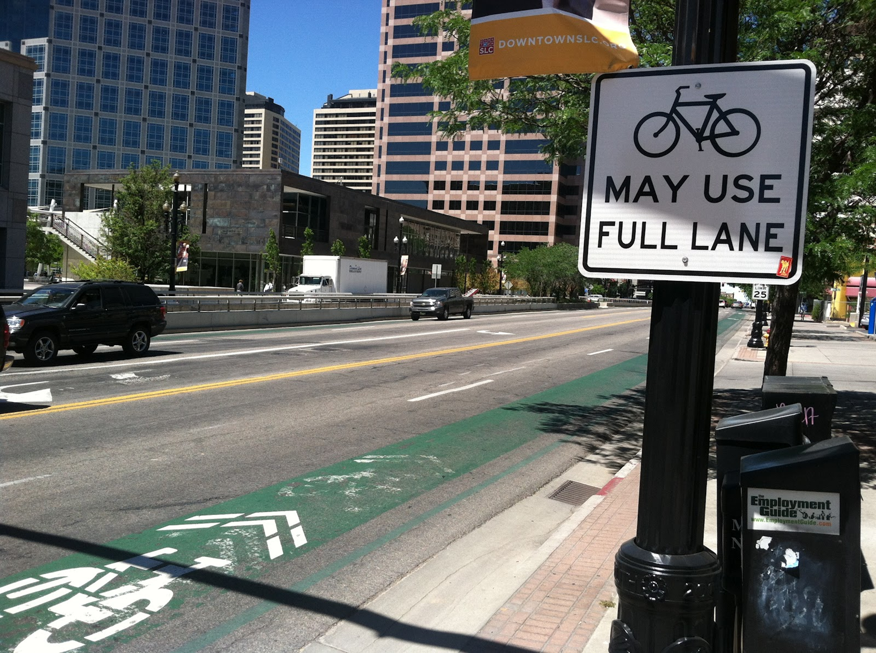

Slide 13
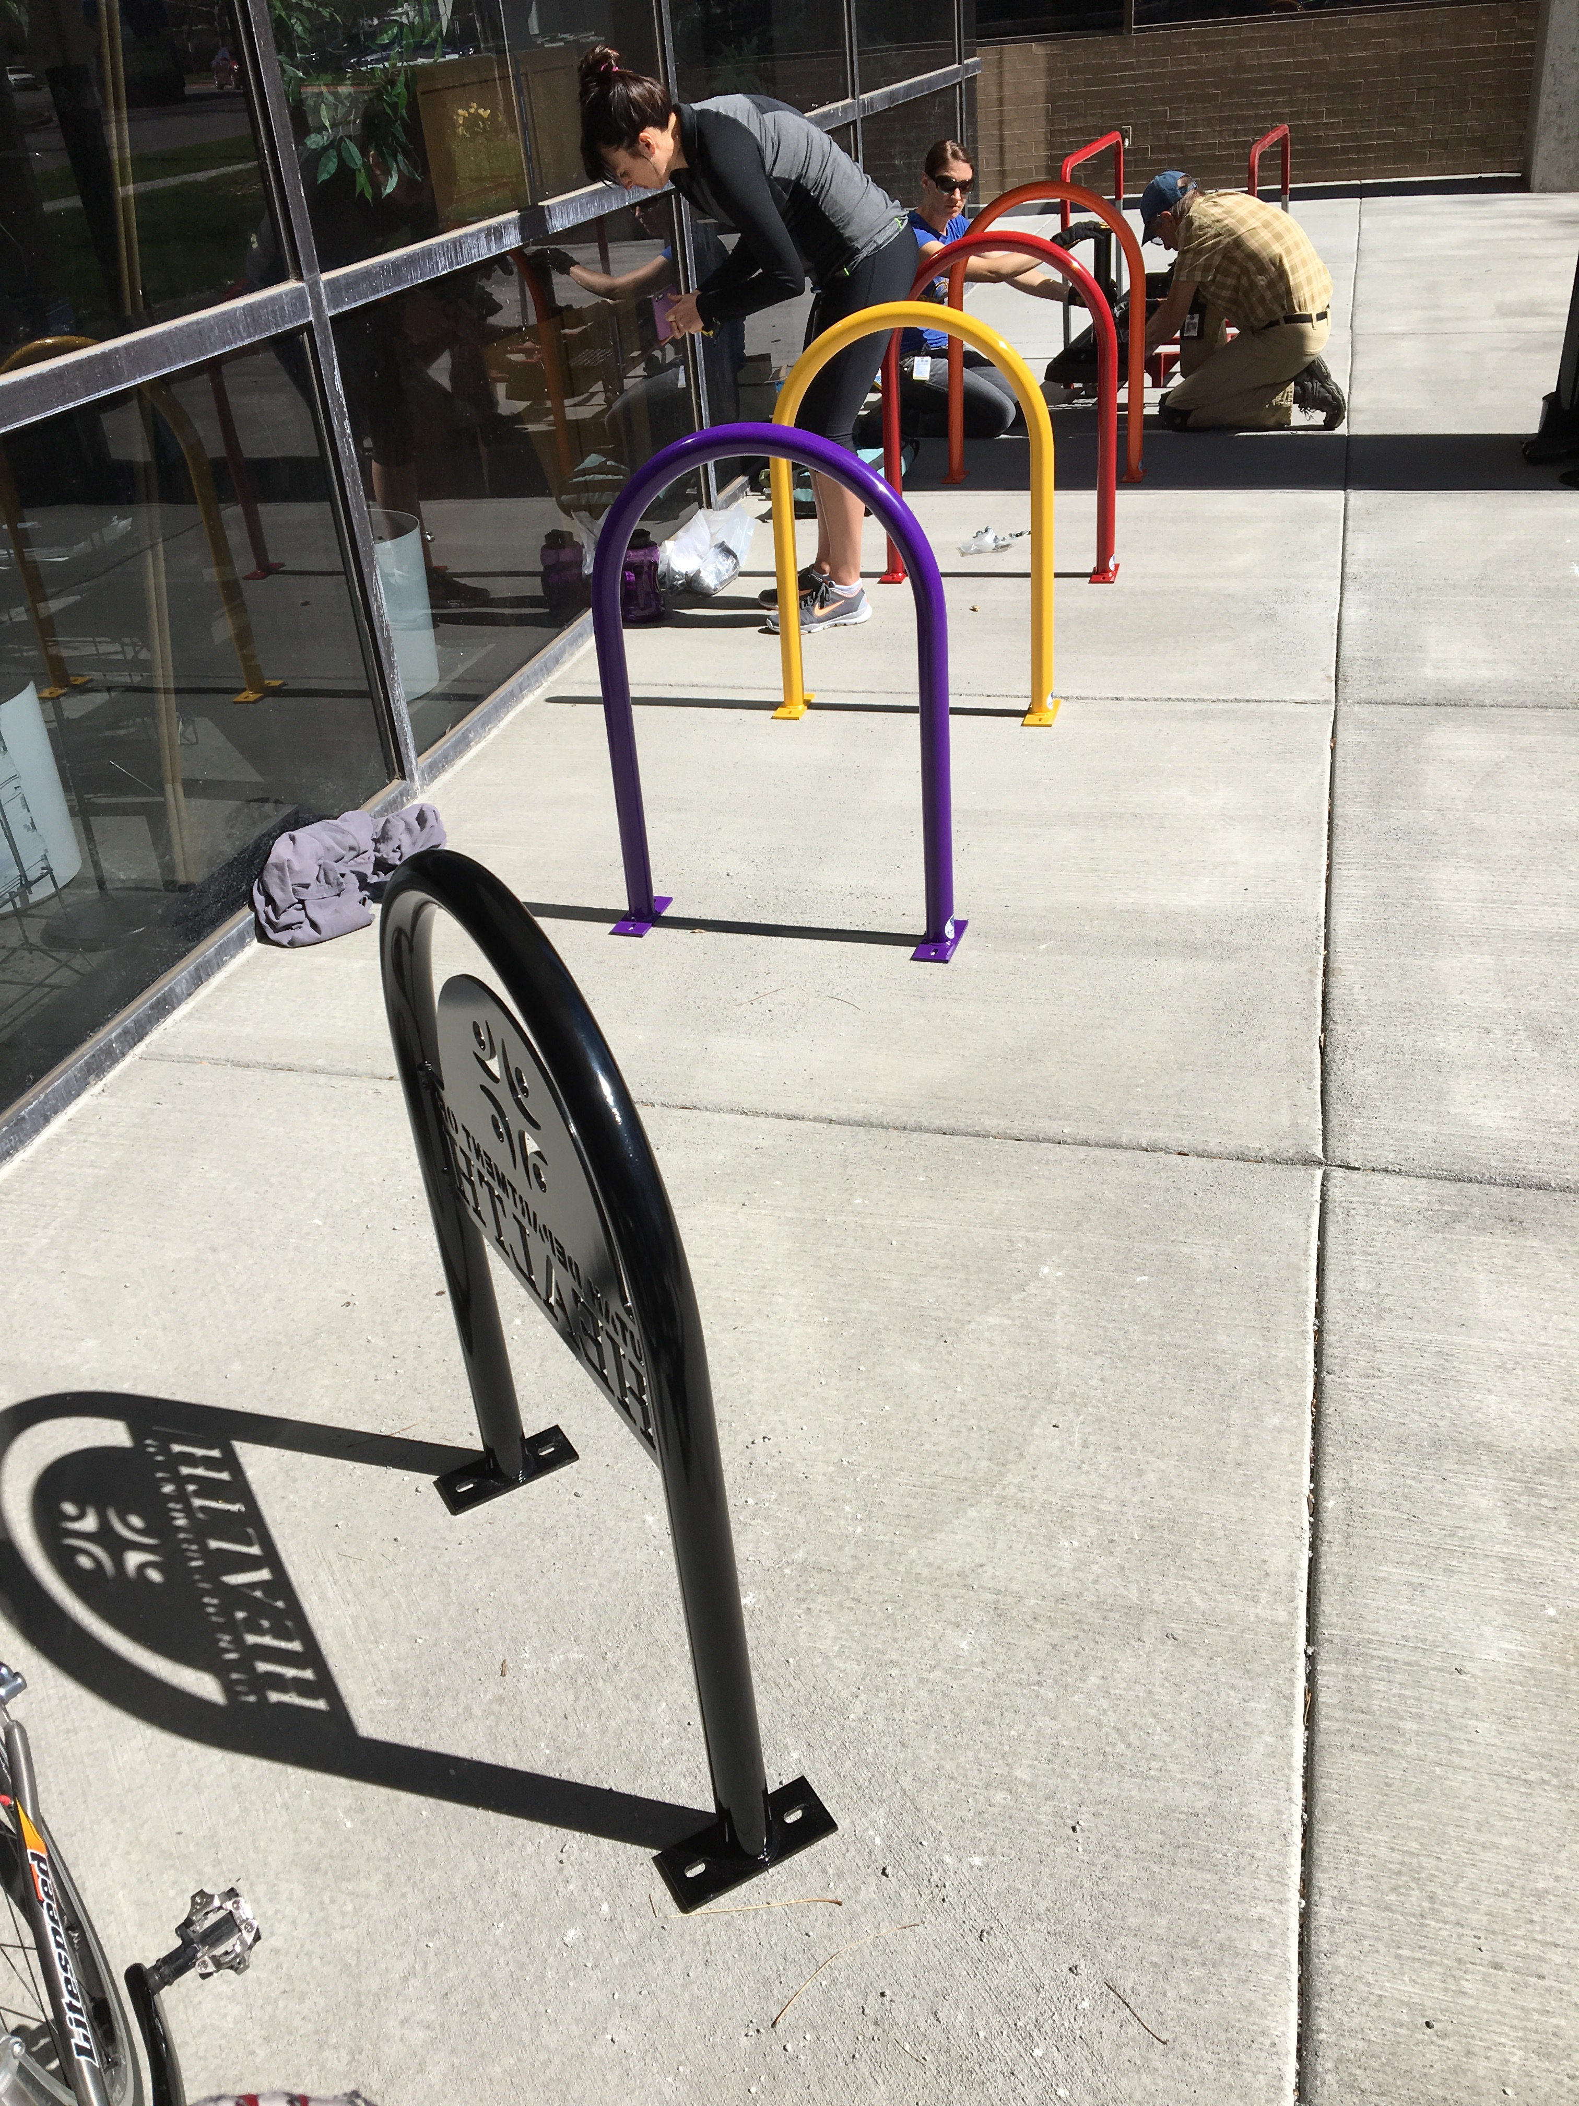

Slide 14
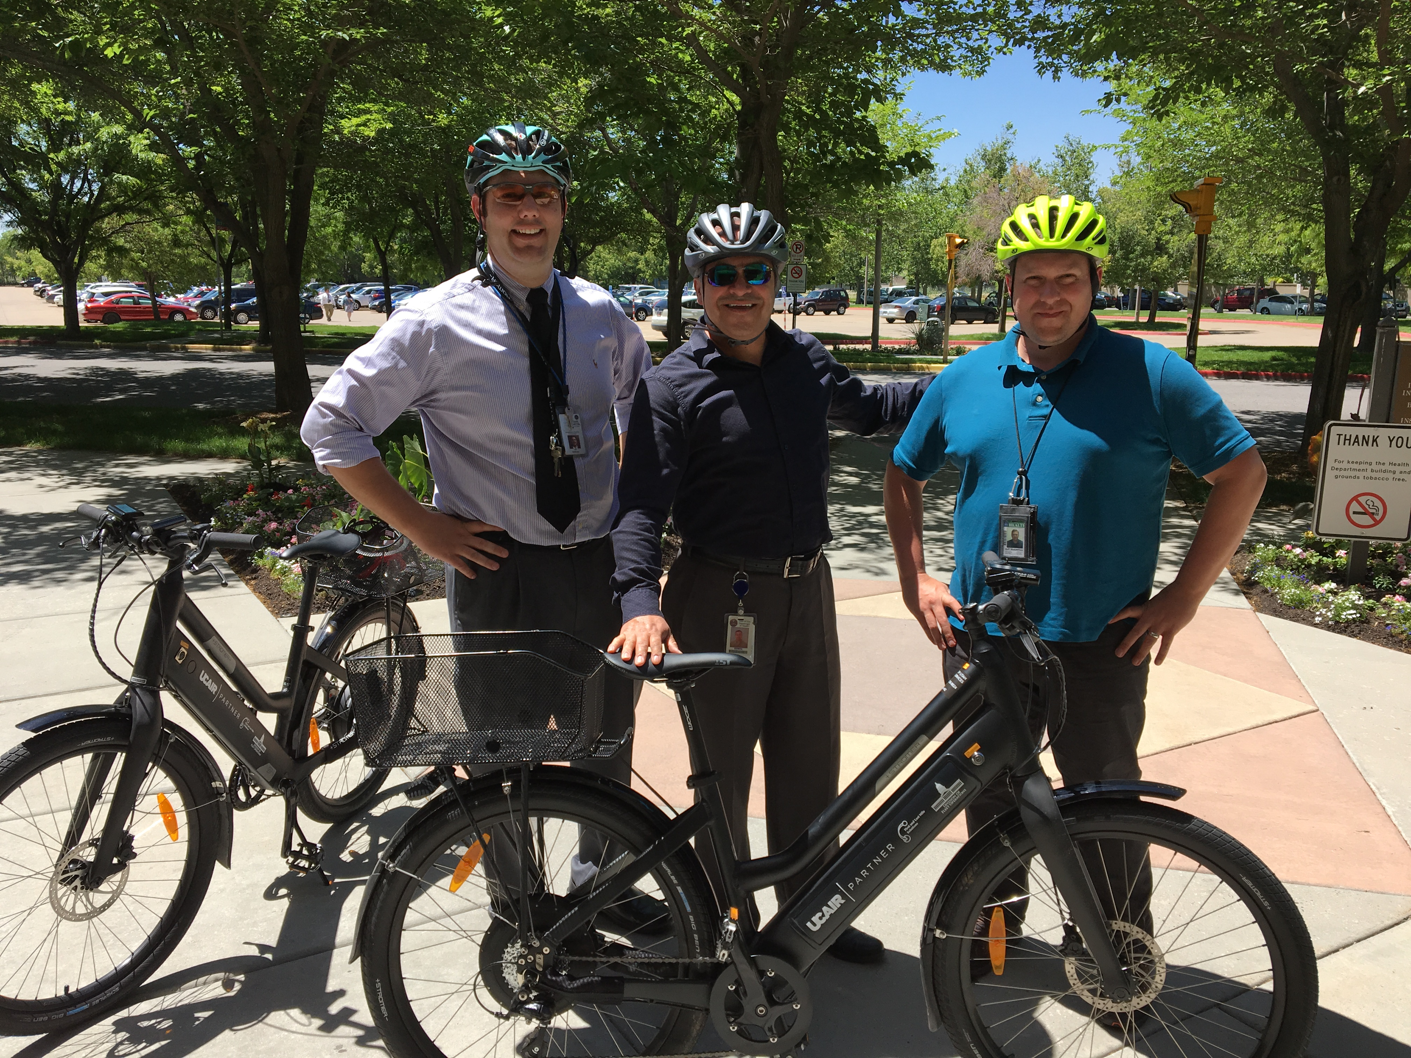

Slide 15
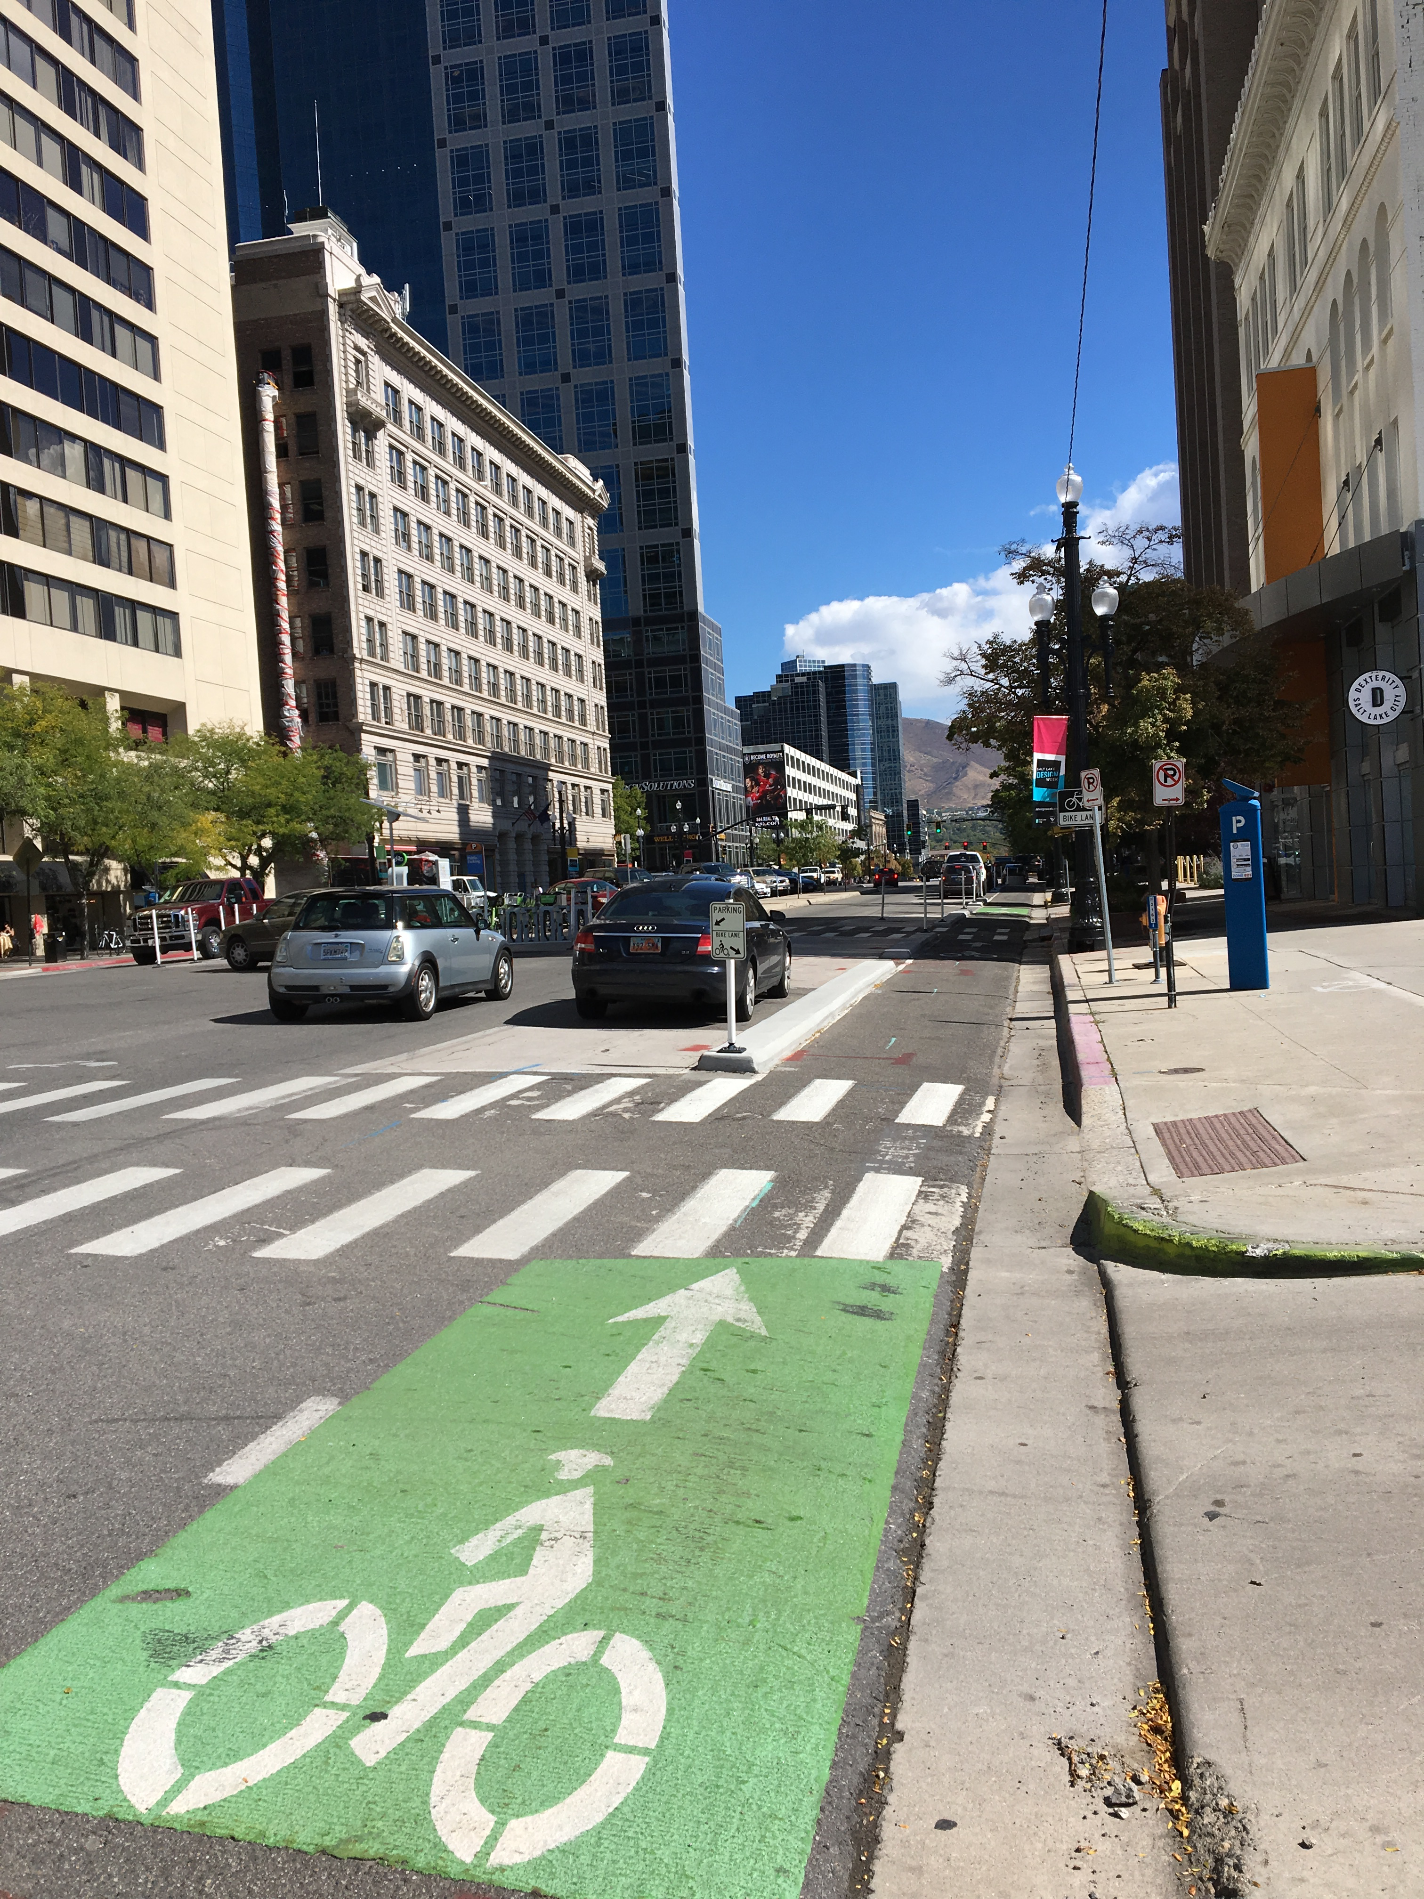

Slide 16
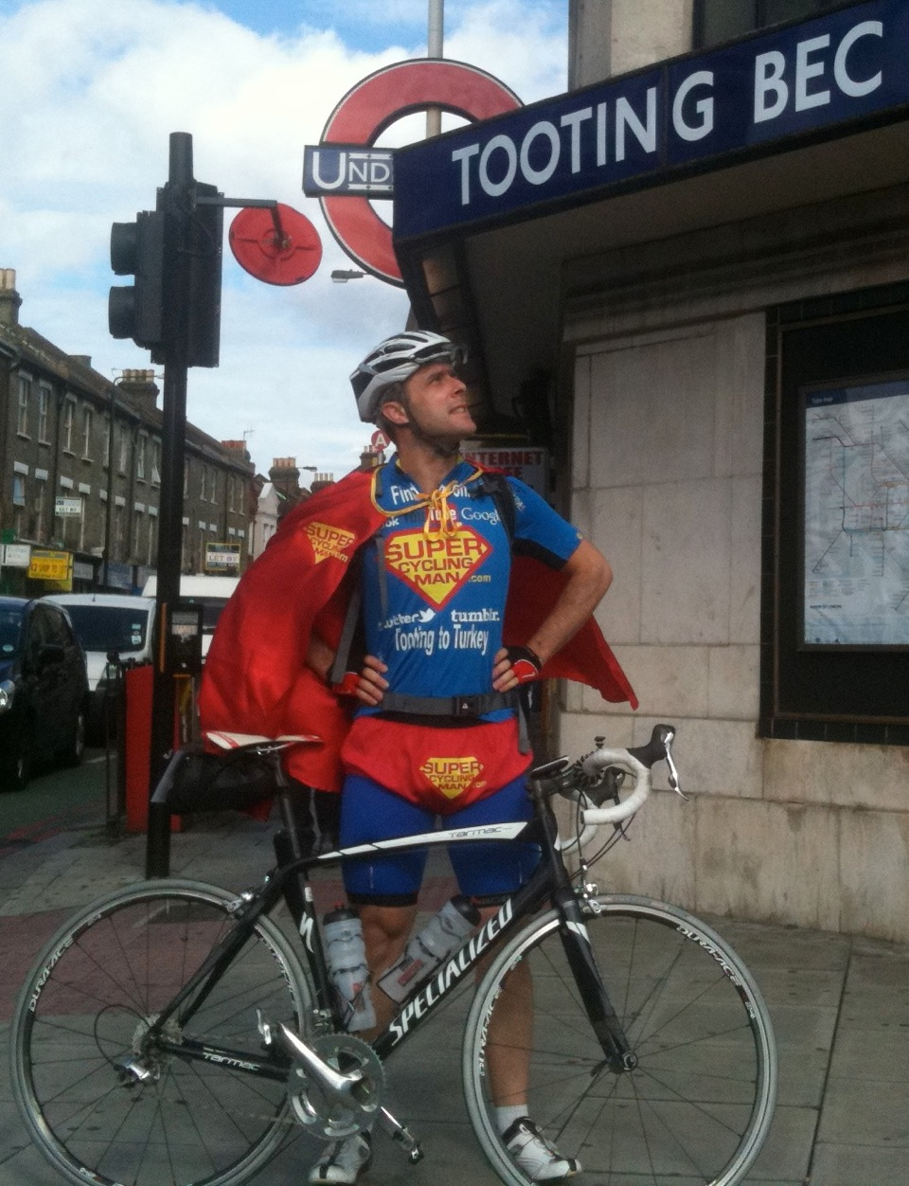

Slide 17
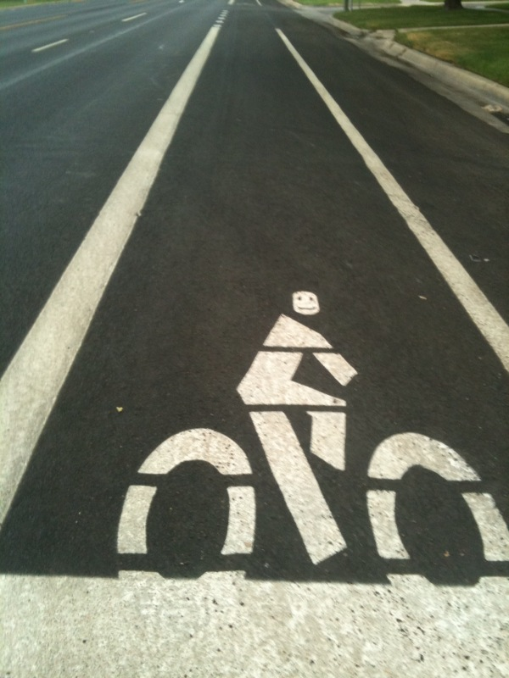
Questions?
Bmciff@Utah.gov
801-538-6530

